Slide 1
NTA projects of
UNFPA Eastern Europe and Central Asia
Róbert I. Gál
(Hungarian Demographic Research Institute and Corvinus University)
(gal@demografia.hu)
NTA and public policy: Some perspectives from the United Nations
NTA14, Paris, February 14, 2023

Slide 2
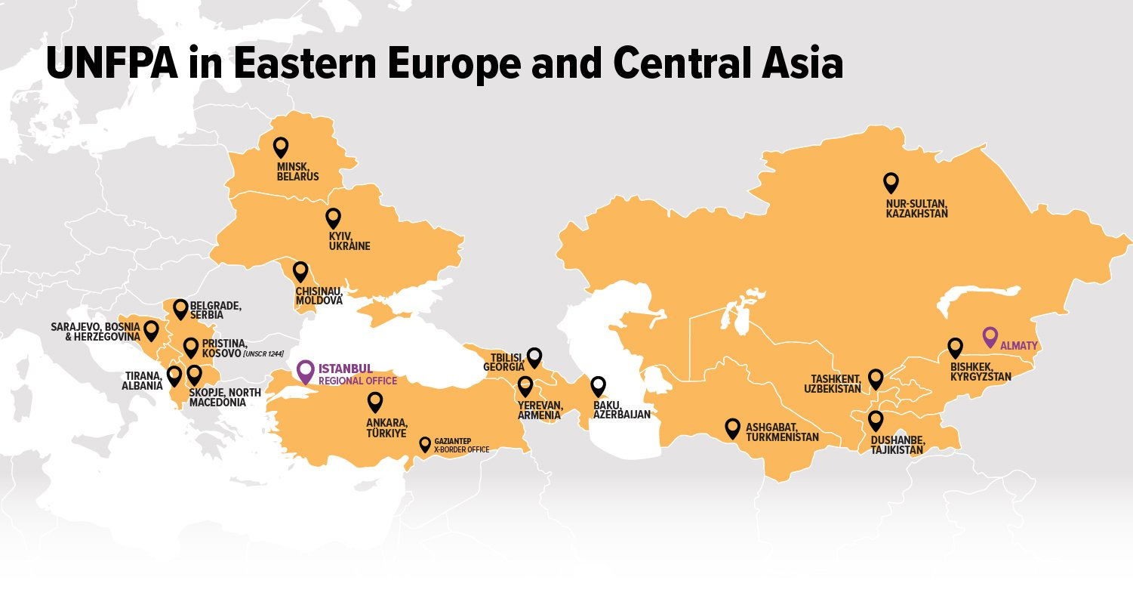
Construction of NTAs and NTTAs: a fundamentally statistical exercise
Before UNFPA became interested: Türkiye
Completed exercises: Moldova, Azerbaijan, Kyrgyzstan, Serbia
Ongoing projects: Tajikistan, Kosovo, Bosnia and Herzegovina (the entire country and separately the two entities), a follow-up exercise in Serbia
Projects in the preparatory phase: North Macedonia; an NTTA project in Serbia
UNFPA EECA supports the construction/ updating of NTAs, and NTTAs, wherever possible

Slide 3
NTA-based policy papers:
Building bridges between NTA specialists and NTA-users
Moldova: NTA-based policy analysis of gender differences
Azerbaijan: an NTA-based policy analysis (still in the planning phase) on how to maintain the stability of the inter-age reallocation system without public asset income
UNFPA EECA puts a special emphasis on separating the construction of NTA/NTTA profile sets and the analysis of the outcome of such exercises
UNFPA EECA wants to be active in inviting users of NTA and building bridges between statisticians and analysts (such as macroeconomists)

Slide 4
Collaboration with other centers
The Higher School of Economics (HSE; Moscow) is active in providing expert support for NTA teams in countries of the Commonwealth of Independent States (CIS), e.g., in Tajikistan and Kyrgyzstan
The CISpop project (Better data for better policies) supports the HSE in building a Center for Excellence in Moscow that provides intellectual and technical support for CIS experts in demography-related projects, including the construction of NTA

Slide 5

Thank you for your attention

